Slide 1
The key
influencer
The key
influencer

Slide 2
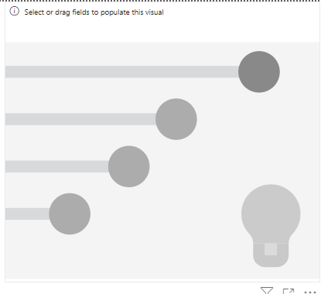
The key influencer
Note: This lab is based on the Excel file customerfeedback.xlsx in the Excel
Add a key influencer visual to the scene

Slide 3
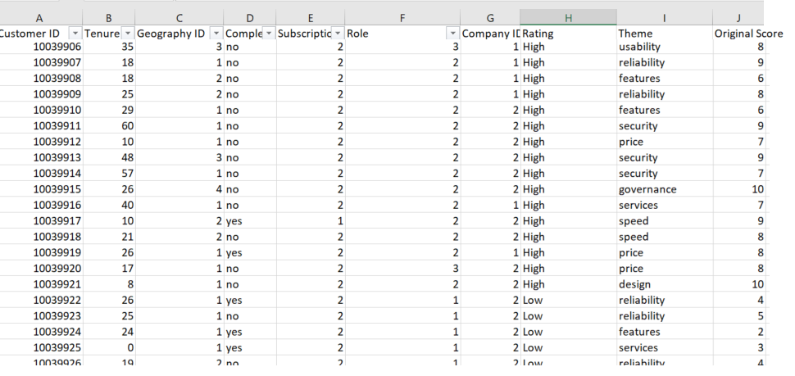
The key influencer
high or low

Slide 4
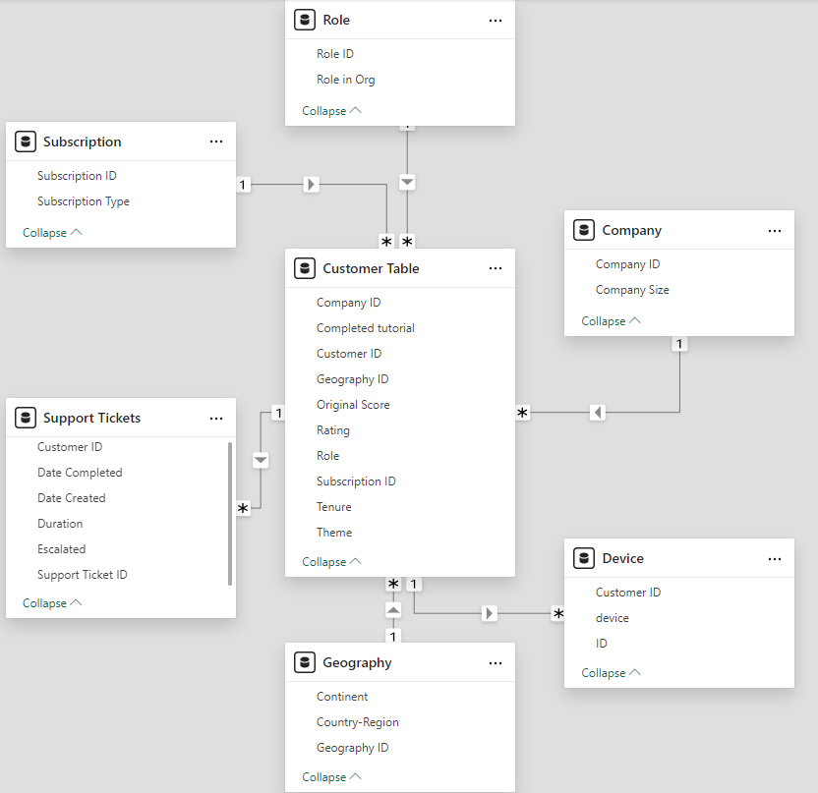
The key influencer
high or low

Slide 5
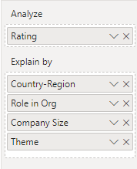
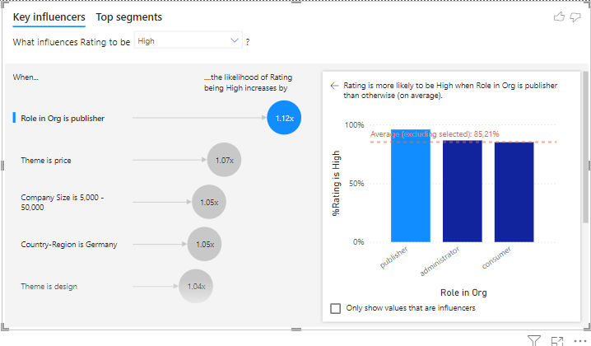
The key influencer
Add Assessment to analyze then Country-Region , Role in the organization ,
Company Size and Theme to be explained by and
observe the change

Slide 6
The key influencer
Role in the organization as “editor” :
The top influencers chart shows that being a publisher increases the likelihood of getting a high rating by 1.12x .
The bar chart validates this, showing 85.21% high ratings for editors
Insight : Editors have a significant positive impact on high ratings .
Recommendation : Focus on publisher engagement and retention, as they contribute the most to high ratings.

Slide 7
The key influencer
Themes :
Themes such as price and design have modest positive impacts ( 1.07x and 1.04x , respectively ).
Overview : These factors slightly increase satisfaction, indicating areas for further refinement.
Recommendation : Highlight competitive pricing and improve design elements to enhance satisfaction.

Slide 8
The key influencer
Regions and company size :
Germany and company size (5,000 to 50,000) contribute to a 1.05 times higher probability of receiving high scores .
Insight : These characteristics define the segments that are more likely to provide positive feedback .
Recommendation : Adapt your strategies to maintain satisfaction in Germany and in medium-sized companies.

Slide 9
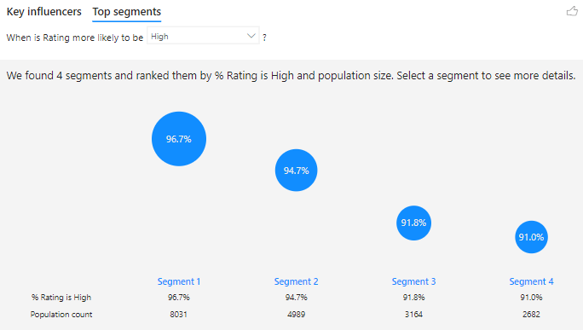
The key influencer
Analyze the best segments for a high score
Segments are ranked based on the percentage of high scores and population size .
Segment 1 (96.7% high scores, population: 8,031) represents the most satisfied group, followed by other segments with slightly lower scores (94.7%-91.0 %).
Overview : Segment 1 is the most important driver of high ratings due to its size and high satisfaction rate .
Recommendation : Identify the characteristics of this segment and reproduce its conditions in other groups.

Slide 10
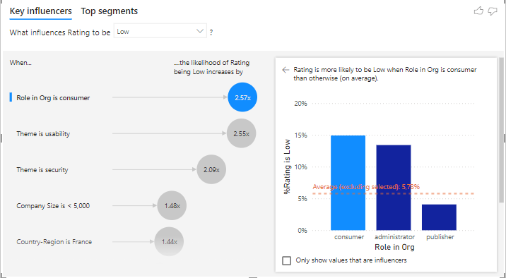
The key influencer
Role in the organization as a “consumer” :
The graph shows that consumers are 2.57 times more likely to give poor ratings. The bar graph shows that consumers exceed the average percentage of poor ratings ( 5.78% ).
Insight : Consumers are the most dissatisfied group.
Recommendation : Study their challenges and prioritize solving their problems.

Slide 11
The key influencer
Themes and company sizes :
usability and security significantly influence low scores ( 2.55x and 2.09x , respectively).
Small businesses (<5,000 employees) are 1.48 times more likely to give poor ratings.
Insight : Usability and security are major dissatisfaction factors, especially for small businesses.
Recommendation : Improve usability and security aspects, targeting small businesses.

Slide 12
The key influencer
Regions :
France is 1.44 times more likely to get poor grades.
Overview : Regional dissatisfaction may be linked to localized factors .
Recommendation : Investigate and address specific regional concerns, particularly in France.

Slide 13
The key influencer
Analyze the best segments for a high score
Segments are ranked based on the percentage of high scores and population size .
Segment 1 (96.7% high scores, population: 8,031) represents the most satisfied group, followed by other segments with slightly lower scores (94.7%-91.0 %).
Overview : Segment 1 is the most important driver of high ratings due to its size and high satisfaction rate .
Recommendation : Identify the characteristics of this segment and reproduce its conditions in other groups.

Slide 14
Thank you
Thank you

